Slide 1
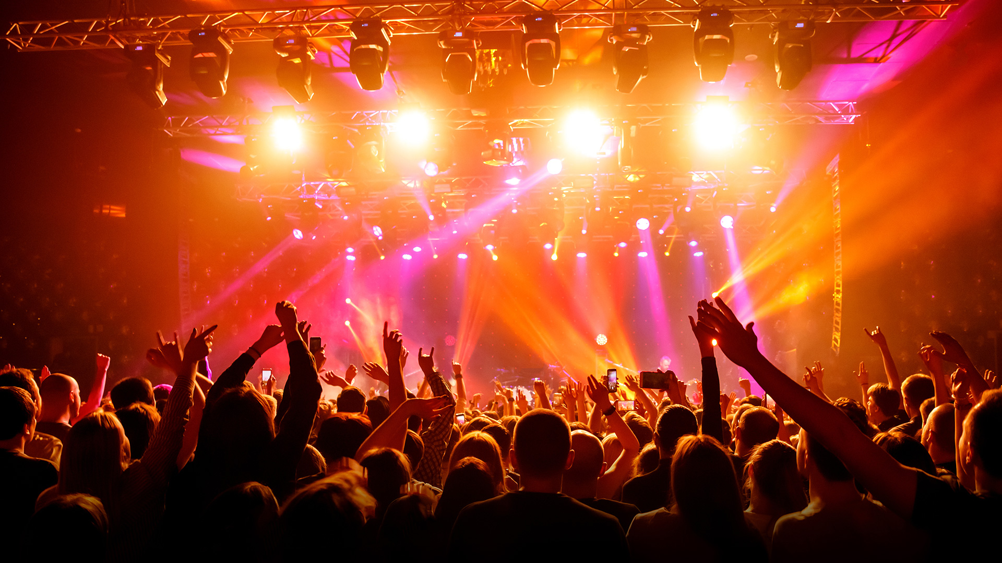
EventEcho
Owen Strumwasser, Richard Lin, Eric Nohara-Leclair

Slide 2
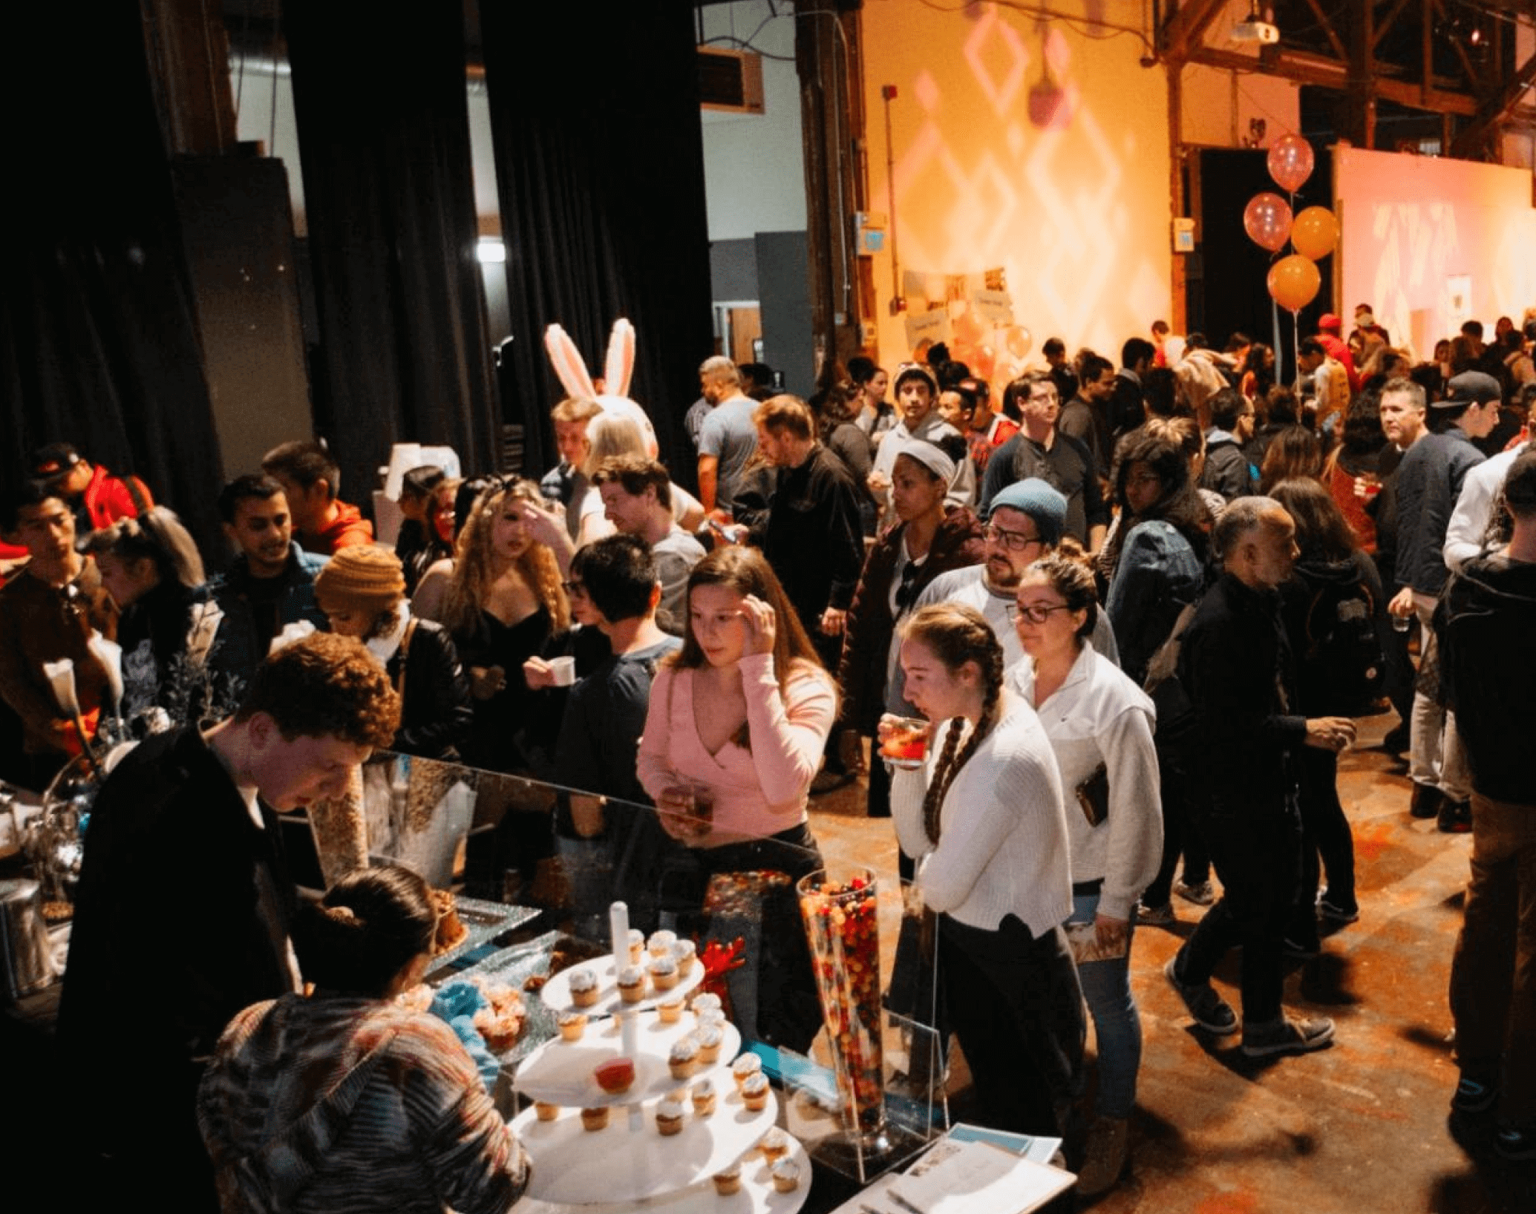
Problem Statement
Event experiences fade fast
No way to relive/preview events
Hard for hosts to see authentic feedback for events

Slide 3
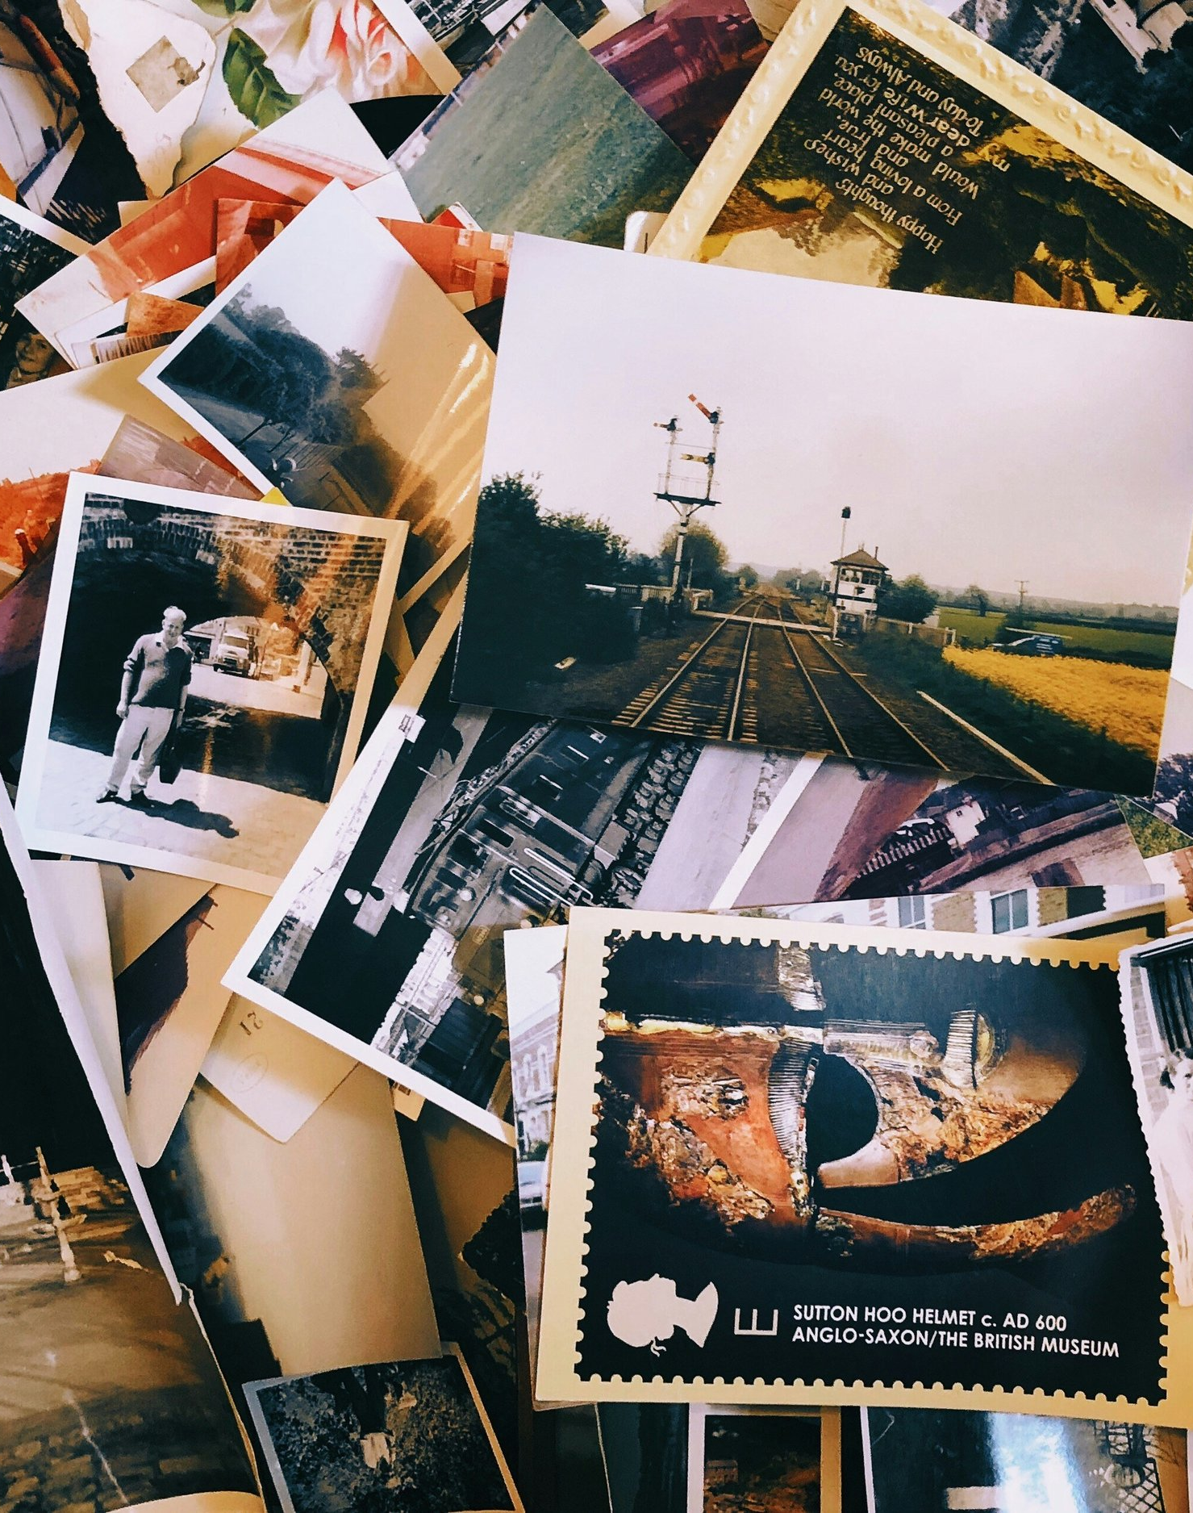
Solution: EventEcho
One shared memory wall per event
Photo-based memories capture real experiences
Discover, preview, and revisit events

Slide 4

App Architecture

Slide 5
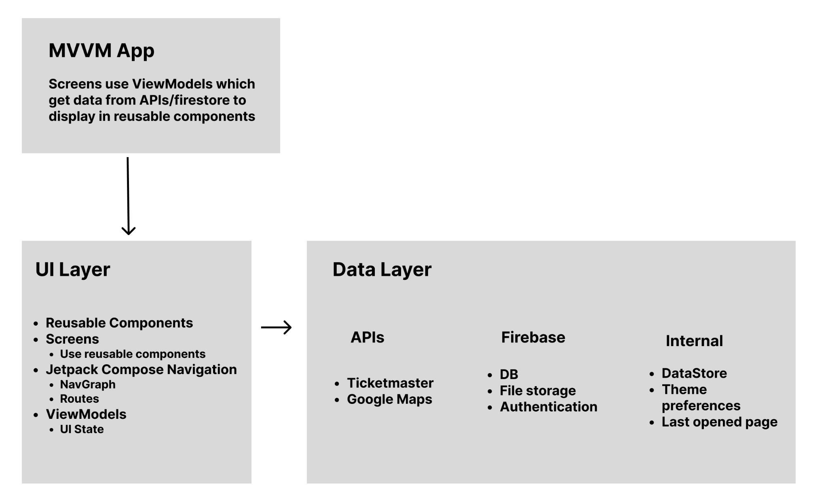

Slide 6
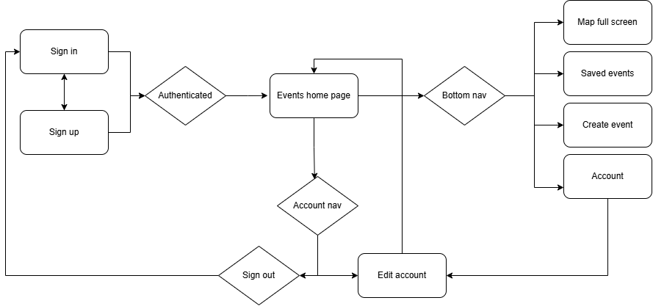

Slide 7
Key Features
Event creation
Event searching/filtering
Memory wall
Memory creation

Slide 8

Changes Since Proposal
Stubs
AR Memory wall
Weather data
Focus on social functionalities
Upvotes
User events
Ranking system

Slide 9
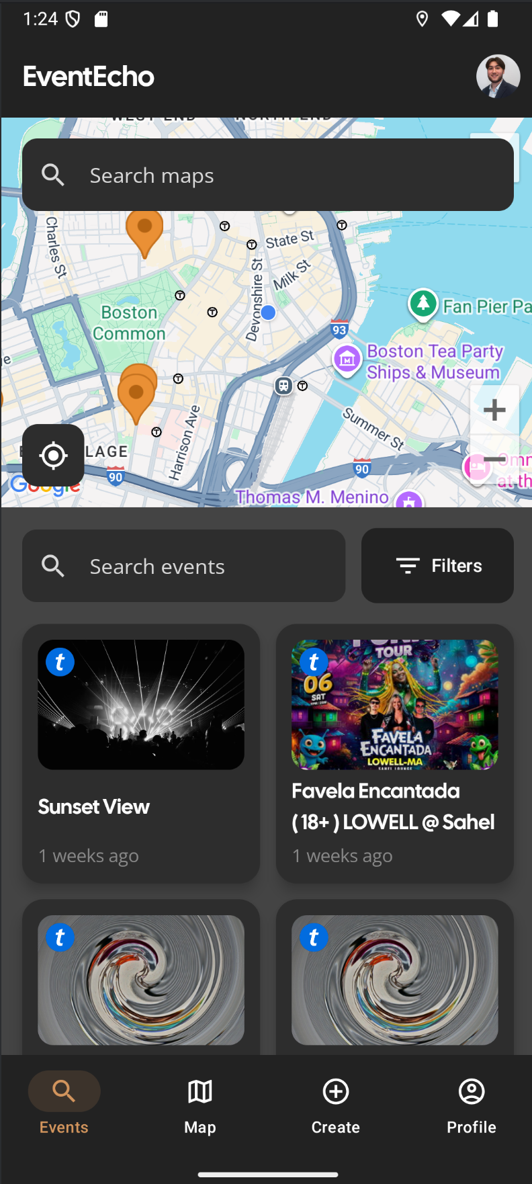
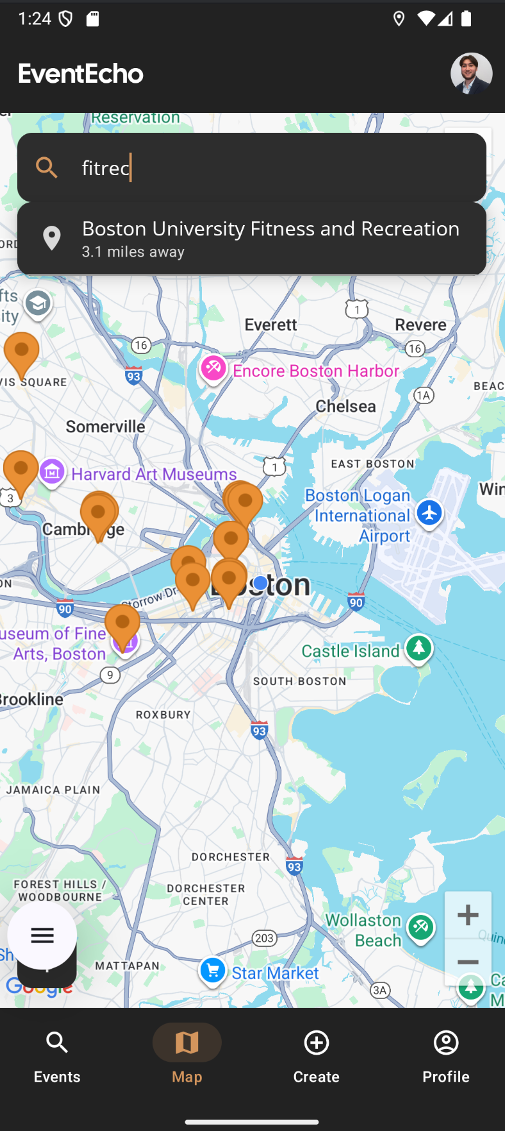
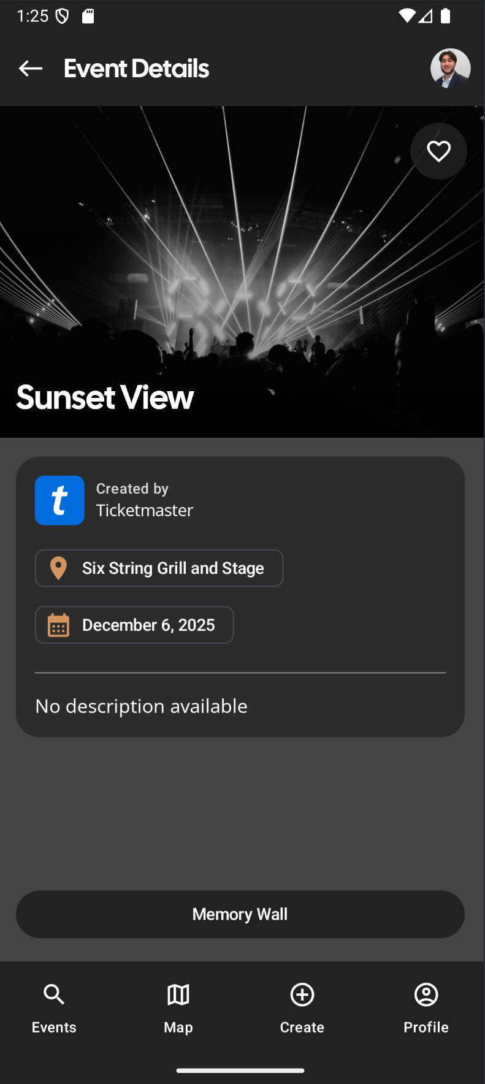
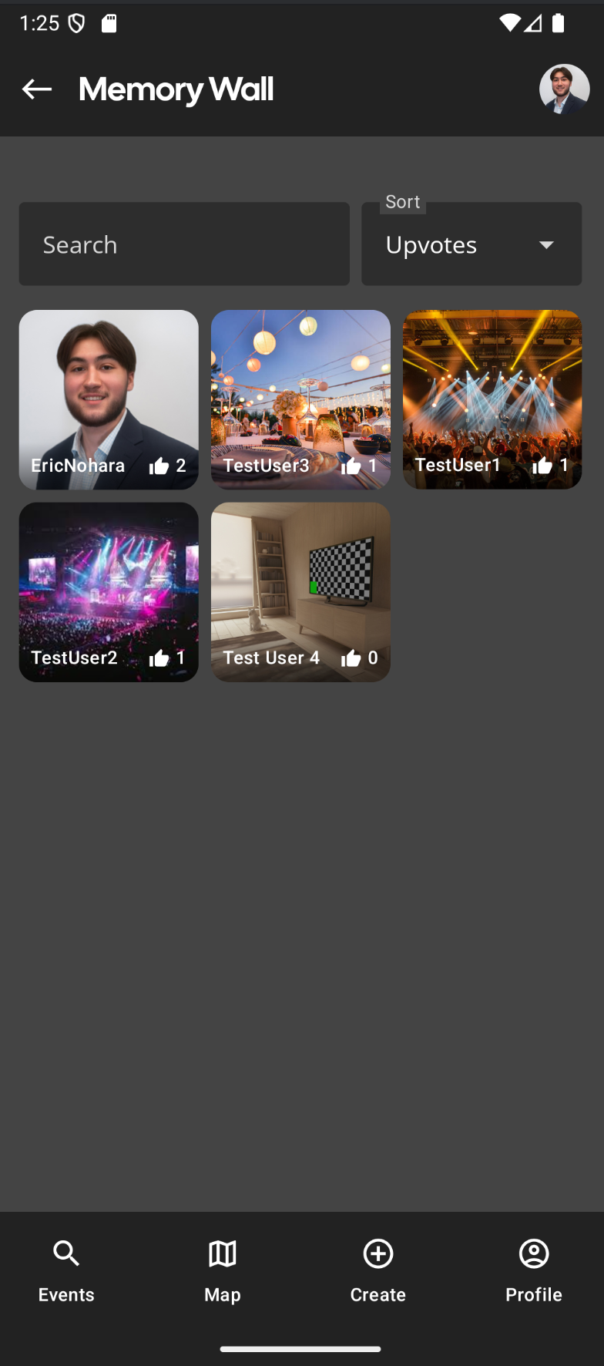

Slide 10
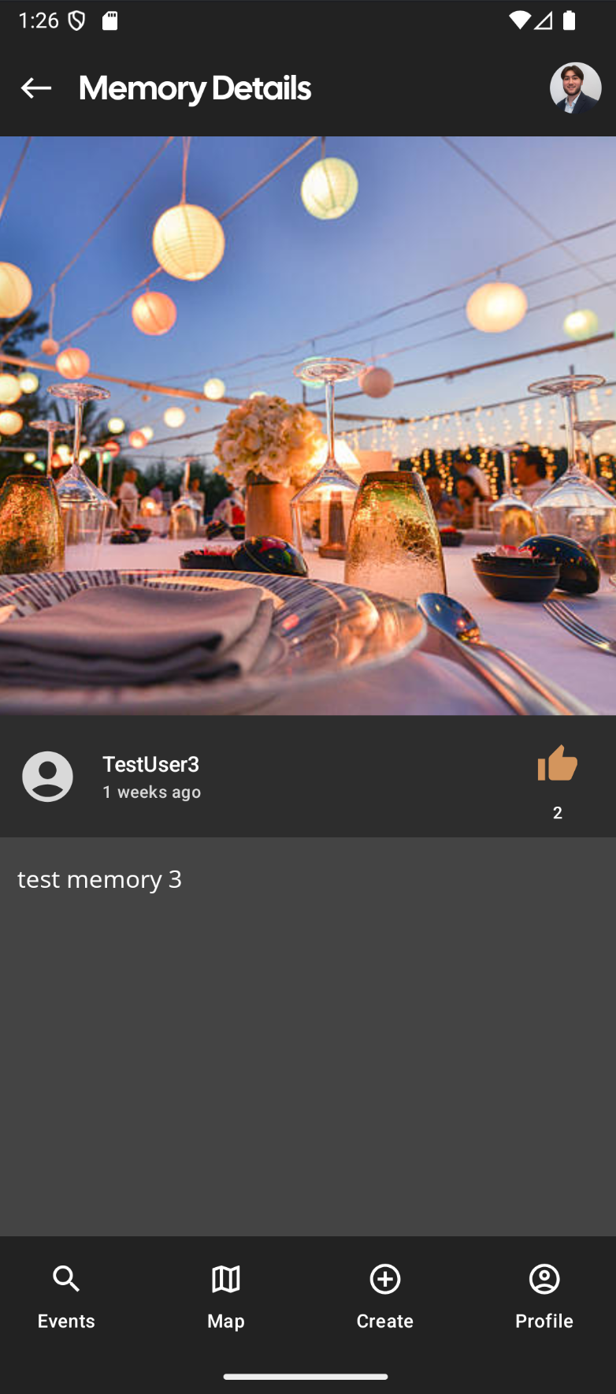
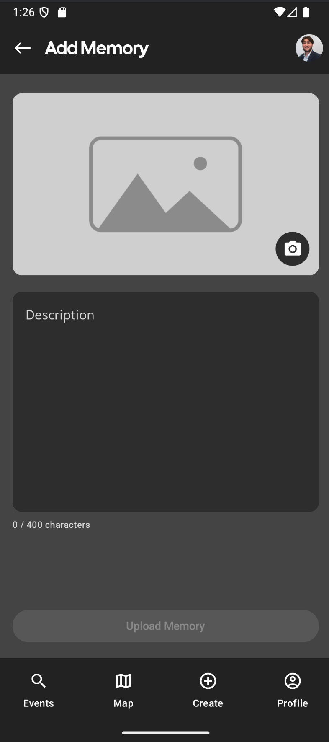
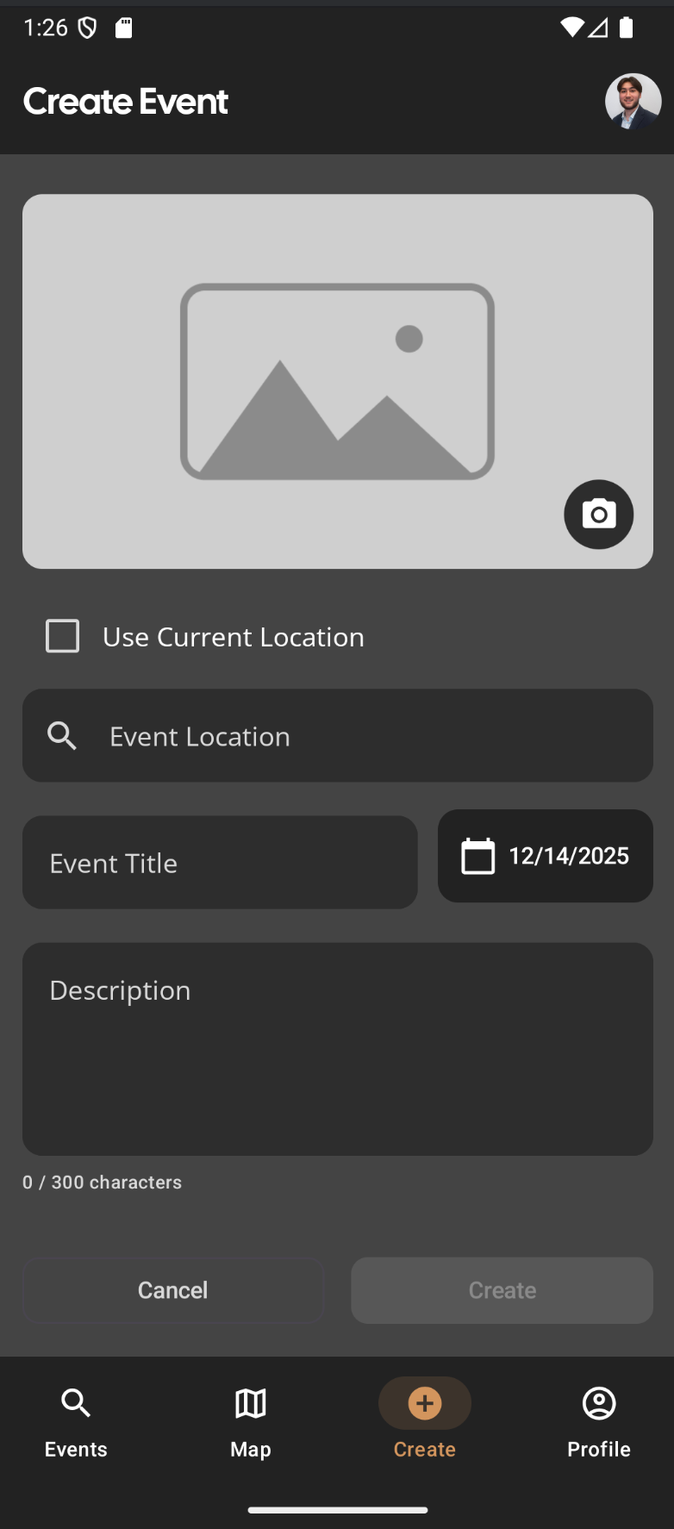
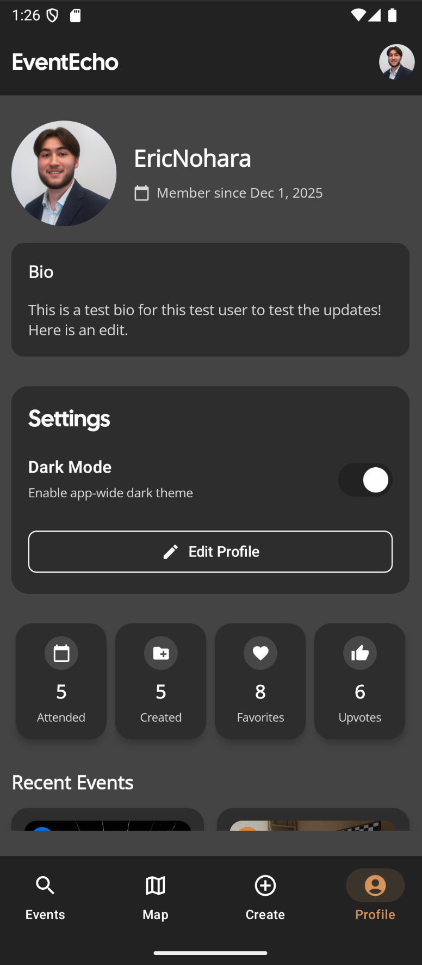

Slide 11
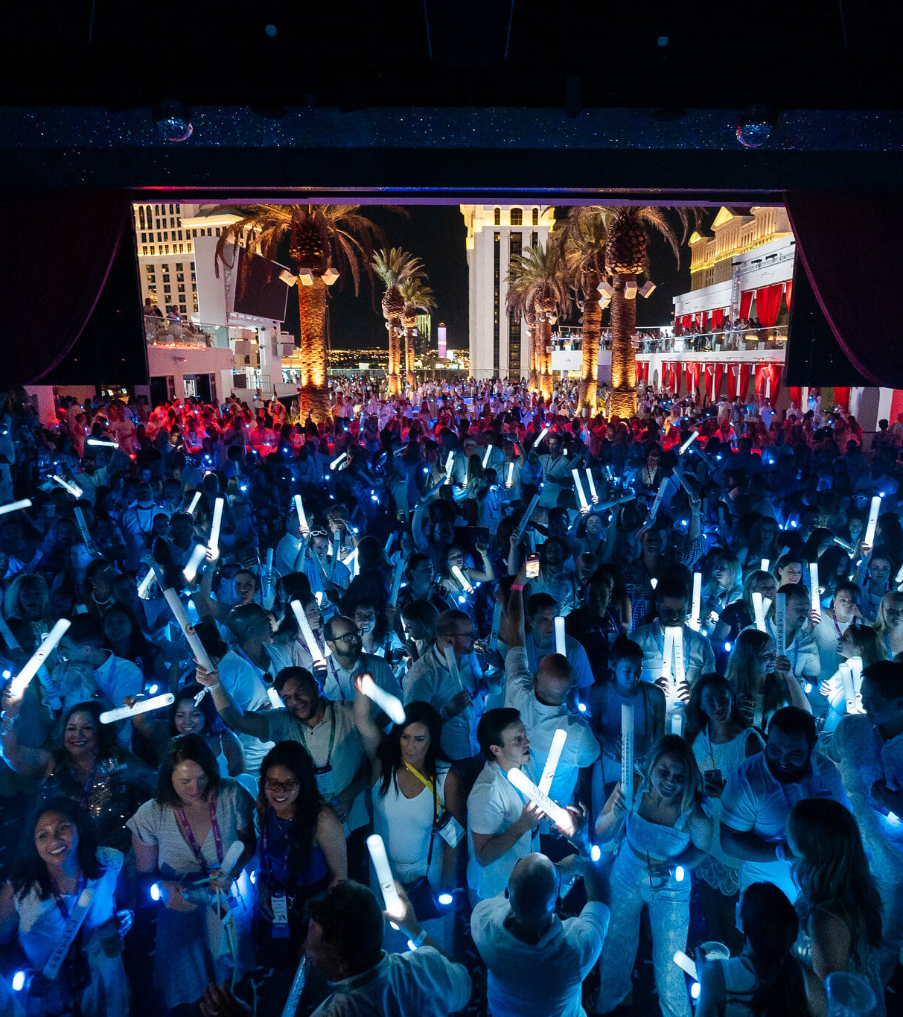
Challenges/Lessons
Large scope + new to Android
Strong upfront planning prevents costly rework
Merge conflicts
Clear team coordination reduces conflicts
Unfamiliar technologies
Iterative design + documentation

Slide 12

AI Usage
Screen wireframes
Debugging
Parsing logs
Double check all code suggested by AI

Slide 13

Future Work
Expand to use other event sources
Add video feature
Add friend functionalities

Slide 14
Any Questions?

